Slide 1
Logistic Regression
Classification
Some slides taken from Andrew Ng’s Machine Learning course https://www.coursera.org/learn/machine-learning

Slide 2
Classification
Supervised machine learning: Learn to predict target values from labelled data/
Classification (target values are discrete classes)
Regression (target values are continuous values)
Given examples of a function (X, F(X))
Predict function F(X) for new examples X
Discrete F(X): Classification
Continuous F(X): Regression
F(X) = Probability(X): Probability estimation

Slide 3


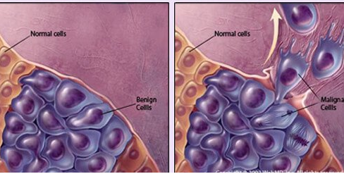

Examples:
Email: Spam / Not Spam?
Features: sender-domain, length, #images, keywords
Labels: spam or non-spam
Online Transactions: Fraudulent (Yes / No)?
Features: item, volume, price, shipping
Labels: fraud or OK
Tumor: Malignant / Benign ?
Features: pixels
Labels: benign or malignant tumor
0: “Negative Class” (e.g., benign tumor)
1: “Positive Class” (e.g., malignant tumor)

Slide 4
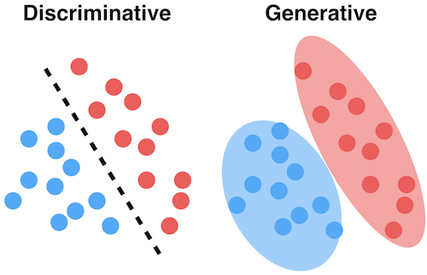
Discriminative and Generative model
A Discriminative model ‌models the decision boundary between the classes.
A Generative Model ‌explicitly models the actual distribution of each class.
Both of these models were generally used in supervised learning problems.

Slide 5
In Math: Discriminative and Generative model
Training classifiers involve estimating f: X -> Y, or P(Y|X)
Generative classifiers
Assume some functional form for P(Y), P(X|Y)
Estimate parameters of P(X|Y), P(Y) directly from training data
Use Bayes rule to calculate P(Y |X)
Example: Hidden Markov Models, Naïve Bayes
Discriminative Classifiers
Assume some functional form for P(Y|X)
Estimate parameters of P(Y|X) directly from training data
Example: Logistic Regression, Support Vector Machines, Neural Networks.

Slide 6
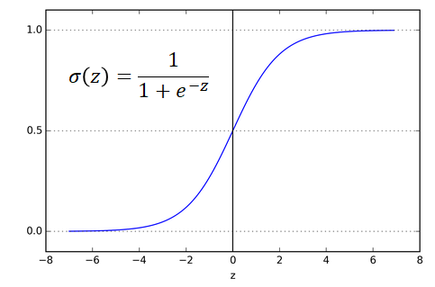


Logistic Regression-Hypothesis Representation
Sigmoid function
Logistic function
Training Set
Learning Algorithm
X
Predicted Y
h
$$h_{w}\left(x\right)=w^{T}x$$
$$h_{w}\left(x\right)=σ\left(w^{T}x\right)$$

Slide 7
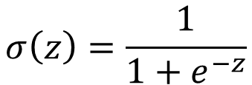

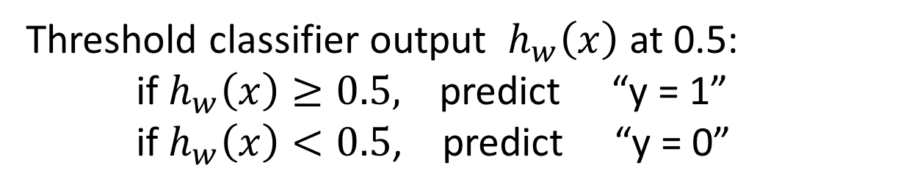
Logistic Regression Model
$$h_{w}\left(x\right)=σ\left(w^{T}x\right)$$
$$σ\left(z\right)=\frac{1}{1+e^{−z}}$$
Logistic Regression: $0<h_{w}\left(x\right)<1$
Threshold classifier output $h_{w}\left(x\right)$ at 0.5:
if $h_{w}\left(x\right)≥0.5,$ predict “y = 1”
if $h_{w}\left(x\right)<0.5$, predict “y = 0”

Slide 8
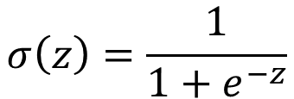
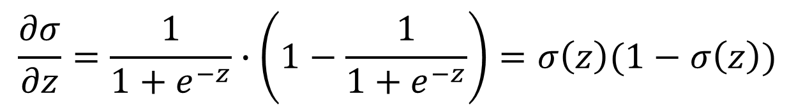
Why sigmoid function?
$$σ\left(z\right)=\frac{1}{1+e^{−z}}$$
$$\frac{∂σ}{∂z}=\frac{1}{1+e^{−z}}∙\left(1−\frac{1}{1+e^{−z}}\right)=σ\left(z\right)(1−σ\left(z\right))$$

Slide 9
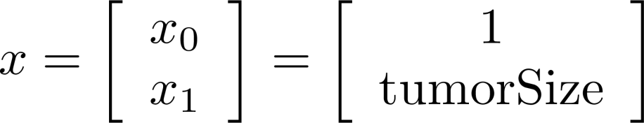
Interpretation of Hypothesis Output
$h_{w}\left(x\right)$ - estimated probability that y = 1 on input x
Example:
If $h_{w}\left(x\right)$ = 0.7 , Tell patient that 70% chance of tumor being malignant
“probability that y = 1, given x, parameterized by w”
$$P\left(y=0|x;w\right)+P\left(y=1|x;w\right)=1$$
$$P\left(y=0|x;w\right)=1− P\left(y=1|x;w\right)$$

Slide 10
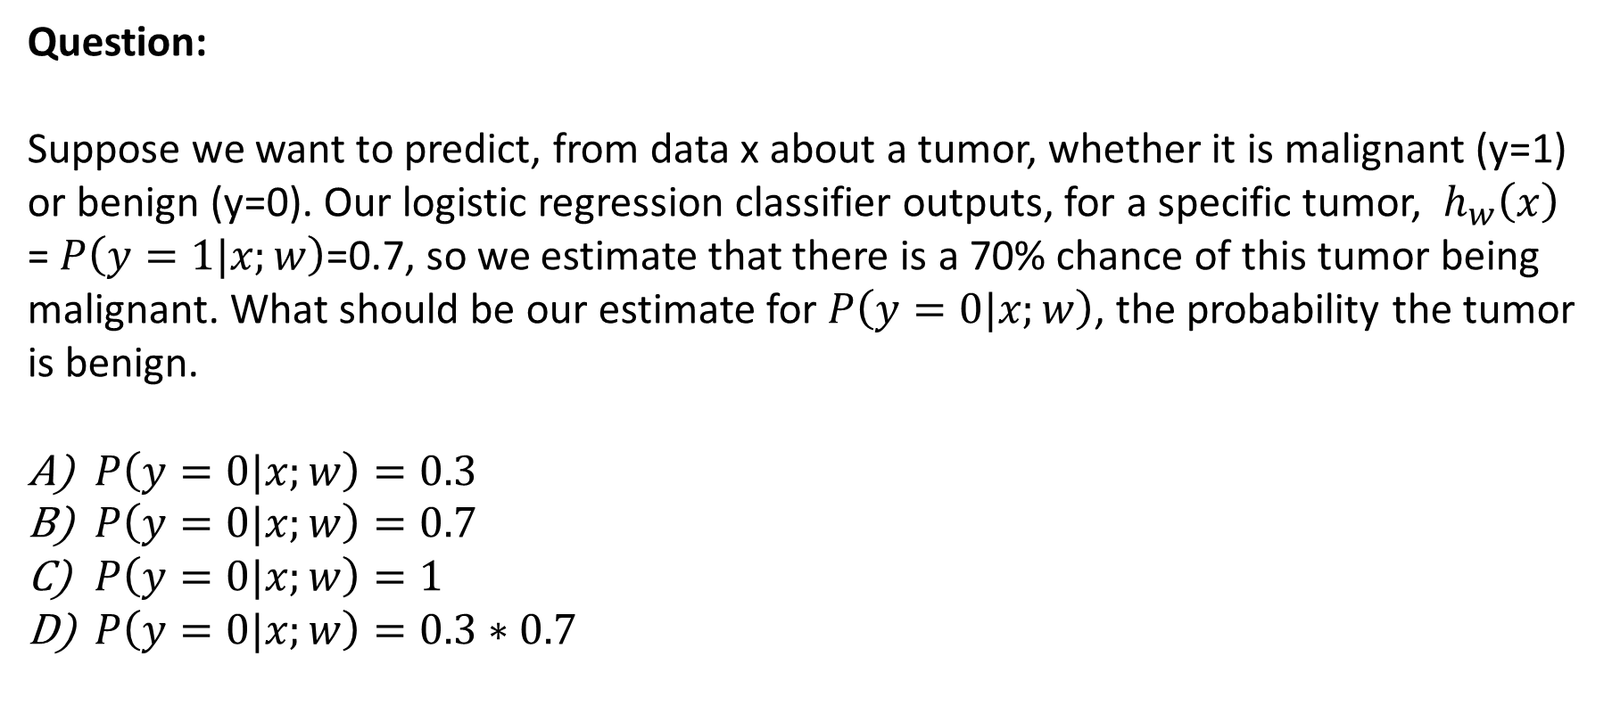
Question:
Suppose we want to predict, from data x about a tumor, whether it is malignant (y=1) or benign (y=0). Our logistic regression classifier outputs, for a specific tumor, $h_{w}\left(x\right)$ = $P\left(y=1|x;w\right)$=0.7, so we estimate that there is a 70% chance of this tumor being malignant. What should be our estimate for $P\left(y=0|x;w\right)$, the probability the tumor is benign.
$P\left(y=0|x;w\right)=0.3$
$P\left(y=0|x;w\right)=0.7$
$P\left(y=0|x;w\right)=1$
$P\left(y=0|x;w\right)=0.3∗0.7$

Slide 11
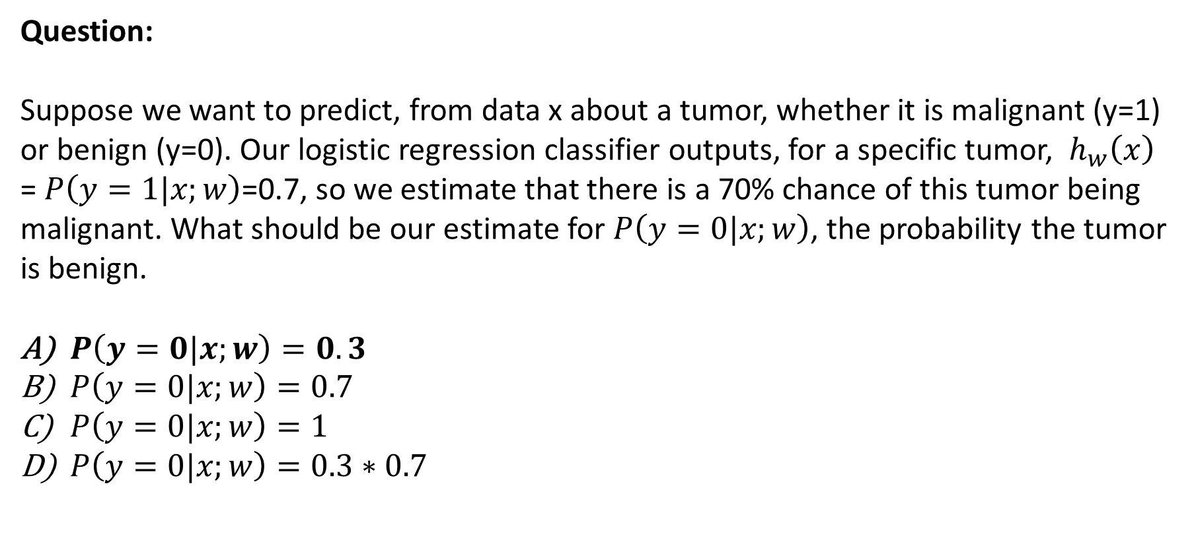
Question:
Suppose we want to predict, from data x about a tumor, whether it is malignant (y=1) or benign (y=0). Our logistic regression classifier outputs, for a specific tumor, $h_{w}\left(x\right)$ = $P\left(y=1|x;w\right)$=0.7, so we estimate that there is a 70% chance of this tumor being malignant. What should be our estimate for $P\left(y=0|x;w\right)$, the probability the tumor is benign.
$P\left(y=0|x;w\right)=0.3$
$P\left(y=0|x;w\right)=0.7$
$P\left(y=0|x;w\right)=1$
$P\left(y=0|x;w\right)=0.3∗0.7$

Slide 12
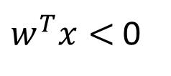

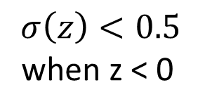
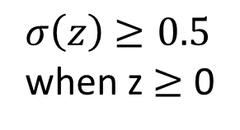
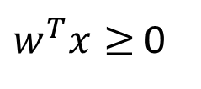

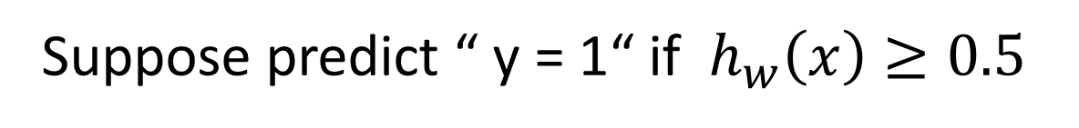
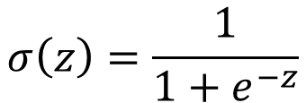
Logistic regression - Decision boundary
$$h_{w}\left(x\right)=σ\left(w^{T}x\right)$$
$$σ\left(z\right)=\frac{1}{1+e^{−z}}$$
Suppose predict “ y = 1“ if $h_{w}\left(x\right)≥0.5$
$σ\left(z\right)$ $≥0.5$
when z $≥$ 0
$w^{T}x≥$ 0
predict “ y = 0“ if $h_{w}\left(x\right)<0.5$
$$σ\left(z\right)<0.5$$
when z < 0
$w^{T}x<$ 0

Slide 13
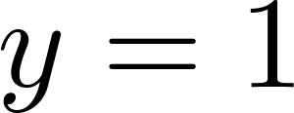
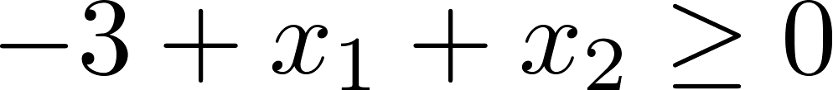

Example: Decision Boundary
x₂
3
$$h_{w}\left(x\right)=σ\left(w_{0}+w_{1}x_{1}+w_{2}x_{2}\right)$$
2
1
1
2
3
x₁
Predict “ “ if

Slide 14
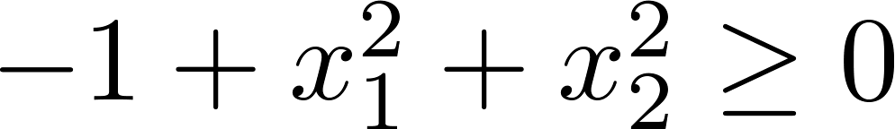


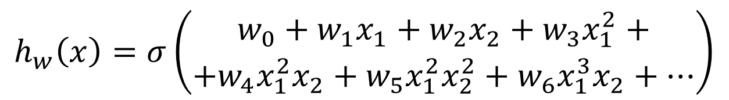
Non-linear decision boundaries
x₂
Decision boundary
y = 1
y = 1
$$h_{w}\left(x\right)=σ\left(w_{0}+w_{1}x_{1}+w_{2}x_{2}+{w_{3}x}_{1}^{2}+{w_{4}x}_{2}^{2}\right)$$
1
y = 0
x₁
-1
1
y = 1
-1
Predict “ “ if
x₂
y = 1
y = 0
x₁
$$h_{w}\left(x\right)=σ\left(\begin{aligned}w_{0}+w_{1}x_{1}+w_{2}x_{2}+{w_{3}x}_{1}^{2}+ \\ +{w_{4}x}_{1}^{2}x_{2}+{w_{5}x}_{1}^{2}x_{2}^{2}+{w_{6}x}_{1}^{3}x_{2}+…\end{aligned}\right)$$

Slide 15
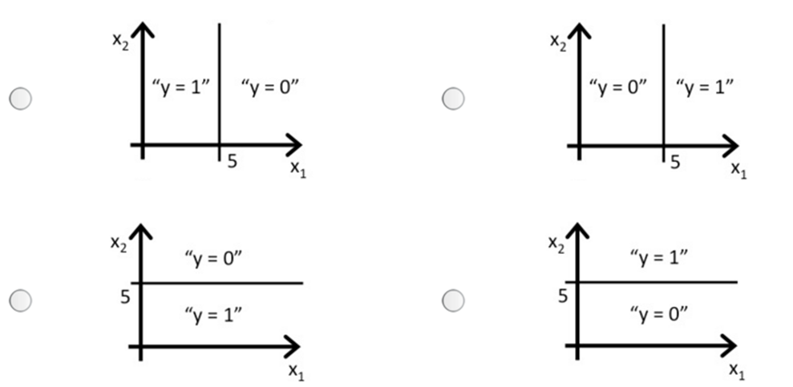
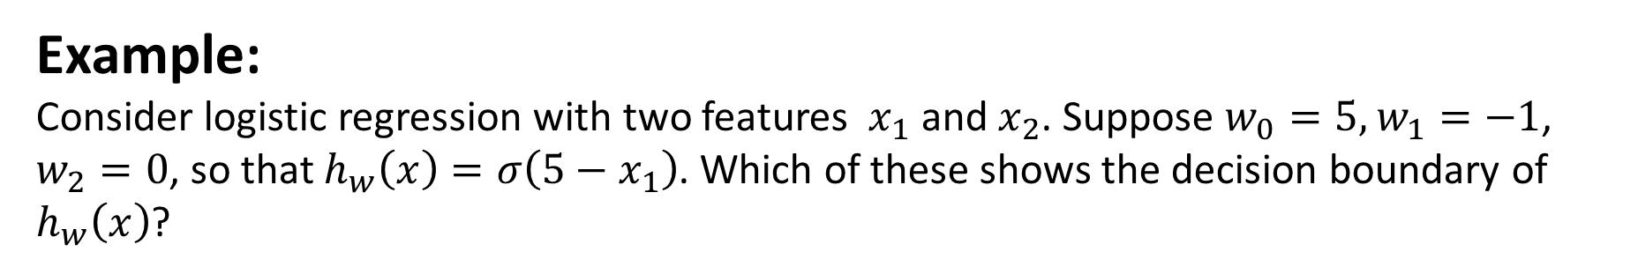
Example:
Consider logistic regression with two features $x_{1}$ and $x_{2}$. Suppose $w_{0}=5,$ $w_{1}=−1$, $w_{2}=0$, so that $h_{w}\left(x\right)=σ\left(5−x_{1}\right)$. Which of these shows the decision boundary of $h_{w}\left(x\right)$?

Slide 16
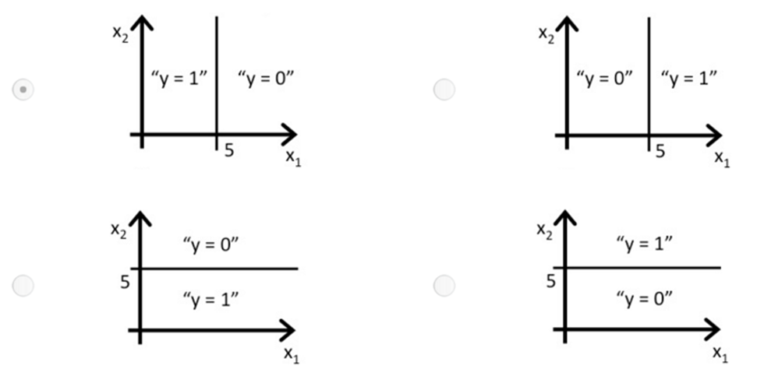
Example:
Consider logistic regression with two features $x_{1}$ and $x_{2}$. Suppose $w_{0}=5,$ $w_{1}=−1$, $w_{2}=0$, so that $h_{w}\left(x\right)=σ\left(5−x_{1}\right)$. Which of these shows the decision boundary of $h_{w}\left(x\right)$?

Slide 17
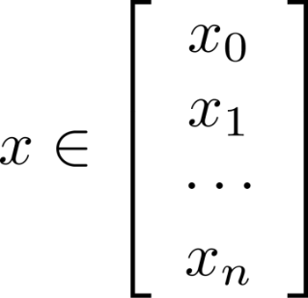

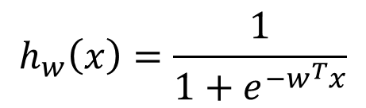
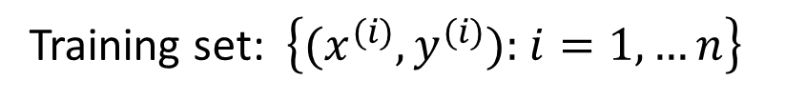
Logistic Regression - Cost function
Training set: $\left\{{(x}^{(i)},y^{(i)})\text{: }i=1,…n\right\}$
$$h_{w}\left(x\right)=\frac{1}{1+e^{−w^{T}x}}$$
Hypothesis:
How to choose parameters w ?

Slide 18
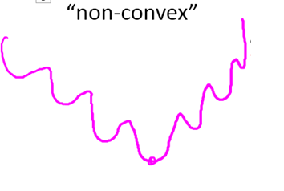

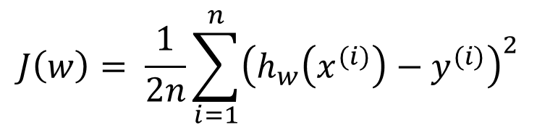



How to define cost function?
$$J\left(w\right)= \frac{1}{2n}\sum_{i=1}^{n}{{\left(h_{w}\left(x^{(i)}\right)−y^{(i)}\right)}^{2}}$$
Linear regression:
$$J\left(w\right)$$
$$J\left(w\right)$$
“convex”
$$w$$
$$w$$

Slide 19

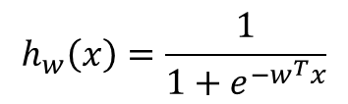


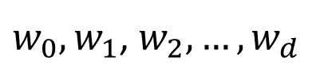
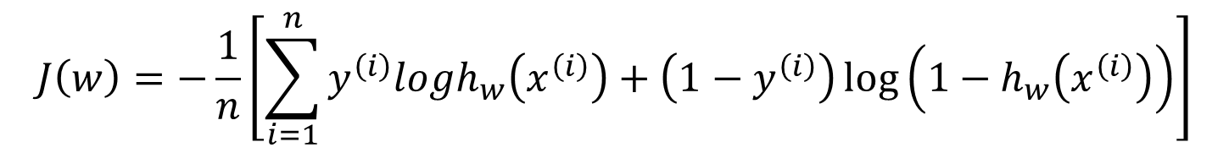
Logistic regression cost function
$$J\left(w\right)=−\frac{1}{n}\left[\sum_{i=1}^{n}{y^{\left(i\right)}logh_{w}\left(x^{\left(i\right)}\right)}+\left(1−y^{\left(i\right)}\right)\log\left(1−h_{w}\left(x^{\left(i\right)}\right)\right)\right]$$
Parameters:
$w_{0},w_{1}$, $w_{2},…,w_{d}$
cross-entropy loss
Goal:
min$J\left(w_{0}{,w}_{1}{,…,w}_{d}\right)$
w
To make a prediction given new :
$$h_{w}\left(x\right)=\frac{1}{1+e^{−w^{T}x}}$$
predict “ y = 1“ if $h_{w}\left(x\right)≥0.5$ or $w^{T}x≥$ 0
predict “ y = 0“ if $h_{w}\left(x\right)<0.5$ or $w^{T}x<$ 0

Slide 20

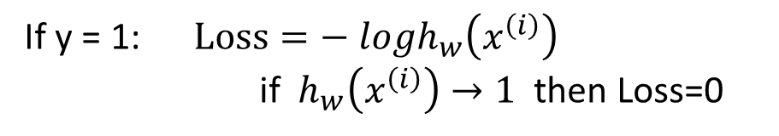

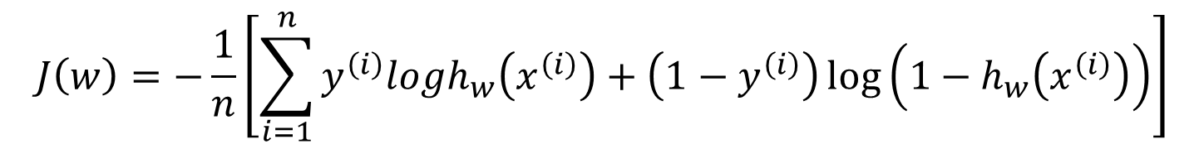

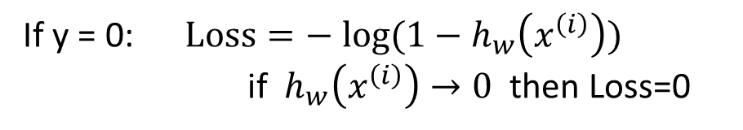

Intuition of Logistic regression cost function
$$J\left(w\right)=−\frac{1}{n}\left[\sum_{i=1}^{n}{y^{\left(i\right)}logh_{w}\left(x^{\left(i\right)}\right)}+\left(1−y^{\left(i\right)}\right)\log\left(1−h_{w}\left(x^{\left(i\right)}\right)\right)\right]$$
Why negative?
${Loss =−[ y}^{\left(i\right)}logh_{w}\left(x^{\left(i\right)}\right)+\left(1−y^{\left(i\right)}\right)\log\left(1−h_{w}\left(x^{\left(i\right)}\right)\right)]$
$$Loss$$
If y = 1
If y = 1: $Loss=− logh_{w}\left(x^{\left(i\right)}\right)$
if $h_{w}\left(x^{\left(i\right)}\right)→1$ then Loss=0
$$Loss$$
If y = 0
0
1
$$h_{w}\left(x\right)$$
If y = 0: $Loss=− log⁡(1−h_{w}\left(x^{\left(i\right)}\right))$
if $h_{w}\left(x^{\left(i\right)}\right)→0$ then Loss=0
0
1
$$h_{w}\left(x\right)$$

Slide 21
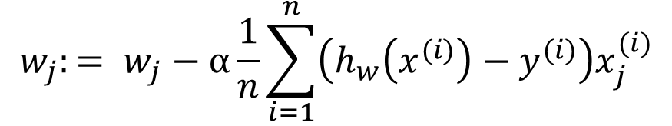
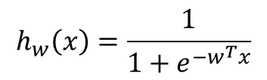


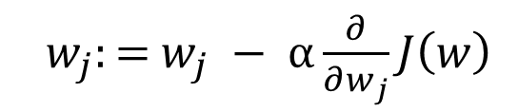
Gradient Descent
$$J\left(w\right)=−\frac{1}{n}\left[\sum_{i=1}^{n}{y^{\left(i\right)}logh_{w}\left(x^{\left(i\right)}\right)}+\left(1−y^{\left(i\right)}\right)\log\left(1−h_{w}\left(x^{\left(i\right)}\right)\right)\right]$$
Goal:
min$J\left(w\right)$
w
Gradient descent:
Repeat
${ w}_{j}:=$ $w_{j} − α\frac{∂}{∂w_{j}}J\left(w\right)$
$$w_{j}:= w_{j}−α\frac{1}{n}\sum_{i=1}^{n}{\left(h_{w}\left(x^{(i)}\right)−y^{(i)}\right)x_{j}^{(i)}}$$
(simultaneously update all $w_{j}$ )
$$h_{w}\left(x\right)=\frac{1}{1+e^{−w^{T}x}}$$
Algorithm looks identical to linear regression!

Slide 22
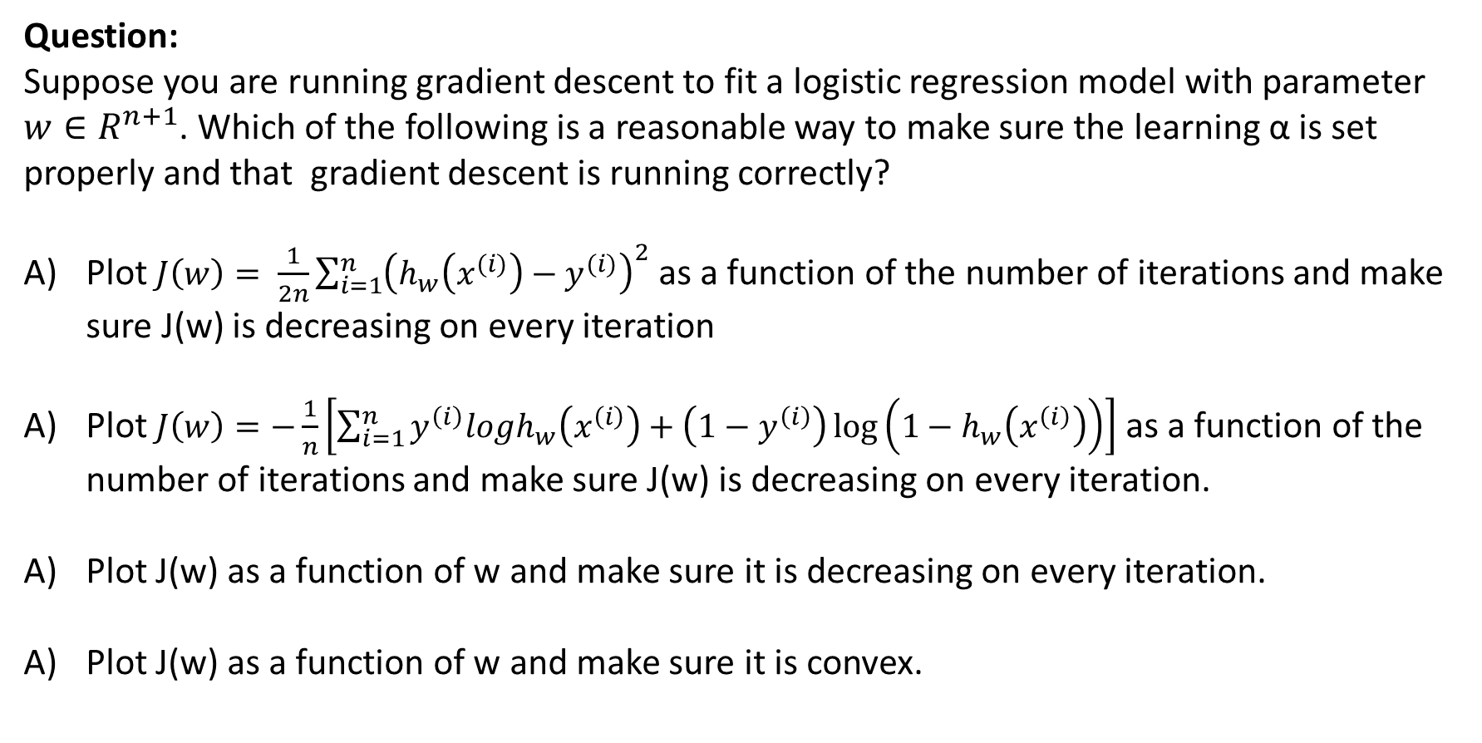
Question:
Suppose you are running gradient descent to fit a logistic regression model with parameter $w∈R^{n+1}$. Which of the following is a reasonable way to make sure the learning α is set properly and that gradient descent is running correctly?
Plot $J\left(w\right)= \frac{1}{2n}\sum_{i=1}^{n}{{\left(h_{w}\left(x^{(i)}\right)−y^{(i)}\right)}^{2}}$ as a function of the number of iterations and make sure J(w) is decreasing on every iteration
Plot $J\left(w\right)=−\frac{1}{n}\left[\sum_{i=1}^{n}{y^{\left(i\right)}logh_{w}\left(x^{\left(i\right)}\right)}+\left(1−y^{\left(i\right)}\right)\log\left(1−h_{w}\left(x^{\left(i\right)}\right)\right)\right]$ as a function of the number of iterations and make sure J(w) is decreasing on every iteration.
Plot J(w) as a function of w and make sure it is decreasing on every iteration.
Plot J(w) as a function of w and make sure it is convex.

Slide 23
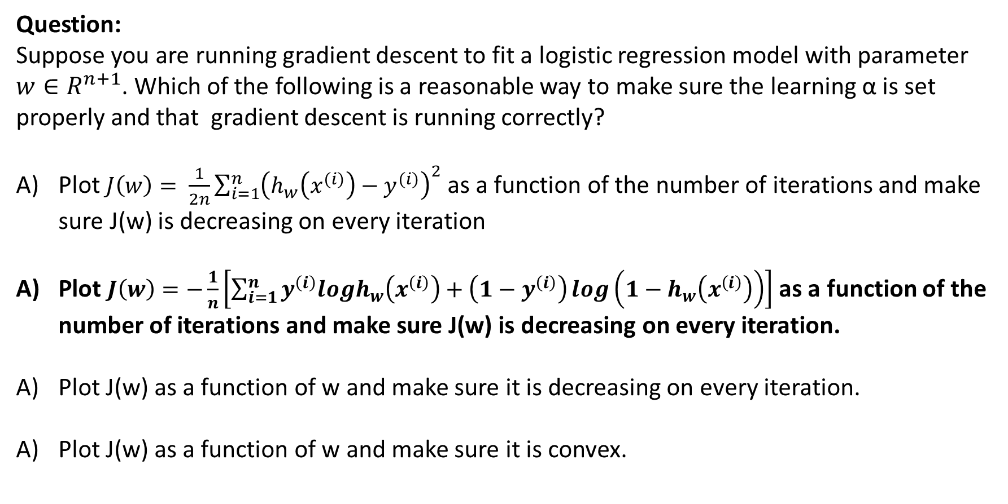
Question:
Suppose you are running gradient descent to fit a logistic regression model with parameter $w∈R^{n+1}$. Which of the following is a reasonable way to make sure the learning α is set properly and that gradient descent is running correctly?
Plot $J\left(w\right)= \frac{1}{2n}\sum_{i=1}^{n}{{\left(h_{w}\left(x^{(i)}\right)−y^{(i)}\right)}^{2}}$ as a function of the number of iterations and make sure J(w) is decreasing on every iteration
Plot $J\left(w\right)=−\frac{1}{n}\left[\sum_{i=1}^{n}{y^{\left(i\right)}logh_{w}\left(x^{\left(i\right)}\right)}+\left(1−y^{\left(i\right)}\right)\log\left(1−h_{w}\left(x^{\left(i\right)}\right)\right)\right]$ as a function of the number of iterations and make sure J(w) is decreasing on every iteration.
Plot J(w) as a function of w and make sure it is decreasing on every iteration.
Plot J(w) as a function of w and make sure it is convex.

Slide 24
Multi-class classification: One-vs-all
Logistic Regression

Slide 25
Multiclass classification
Email foldering/tagging: Work, Friends, Family, Hobby
Medical diagrams: Not ill, Cold, Flu
Weather: Sunny, Cloudy, Rain, Snow

Slide 26
Binary classification:
Multi-class classification:
x₂
x₂
x₁
x₁

Slide 27


x₂
One-vs-all (one-vs-rest):
x₁
x₂
x₂
x₁
x₁
Class 1:
Class 2:
Class 3:
x₂
x₁
$$h_{w}^{i}\left(x\right)=P\left(y=i|x;w\right)$$

Slide 28
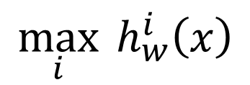

One-vs-all
Train a logistic regression classifier $h_{w}^{i}\left(x\right)$ for each class i to predict the probability that y=i .
On a new input x , to make a prediction, pick the class i that maximizes (Why max?)
$$\max_{i}{{ h}_{w}^{i}\left(x\right)}$$

Slide 29
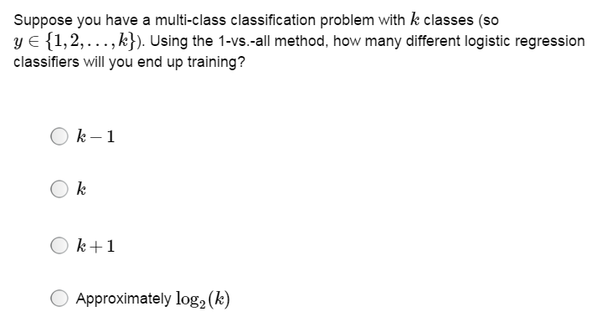

Slide 30
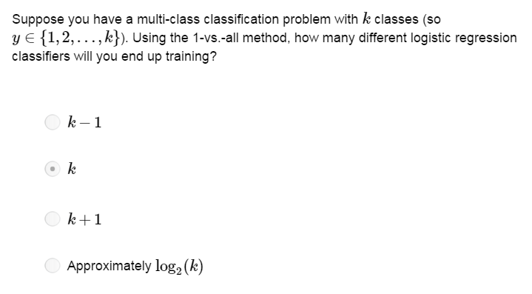

Slide 31
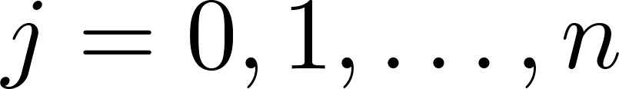
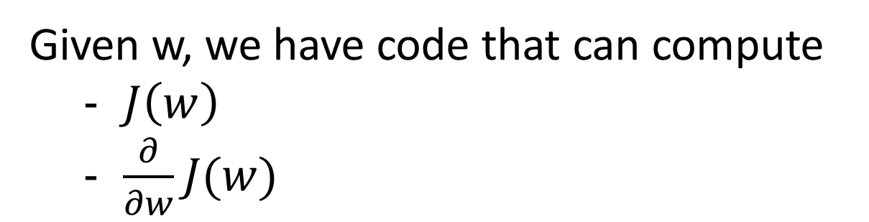
Optimization algorithm – Advanced optimization
Given w, we have code that can compute
$J\left(w\right)$
$\frac{∂}{∂w}J(w)$
(for )
Optimization algorithms:
Gradient descent
Advantages:
No need to manually pick α
Often faster than gradient descent.
Disadvantages:
More complex
Conjugate gradient
BFGS
L-BFGS
Broyden–Fletcher–Goldfarb–Shanno algorithm
Limited-memory BFGS (L-BFGS or LM-BFGS)

Slide 32
Question: Which of the following statements are true? Check all that apply.

Slide 33
Answer

Slide 34
Reading material:
Logistic Regression. Speech and Language Processing. Daniel Jurafsky & James H. Martin. Copyright c 2019. All rights reserved. Draft of October 2, 2019. https://web.stanford.edu/~jurafsky/slp3/5.pdf

